Slide 1
Production line test App
Revolution Robotics Foundation

Slide 2
Requirements
Start the app directly on config screen with a play button
Config can be autosaved
No remote controller config
Modified test codes for motors and sensors
No blockly support, no support for multiple robots, no settings, etc
Top menu buttons are unnecessary
Only 2 screens are needed + Bluetooth modal
Only android app!

Slide 3
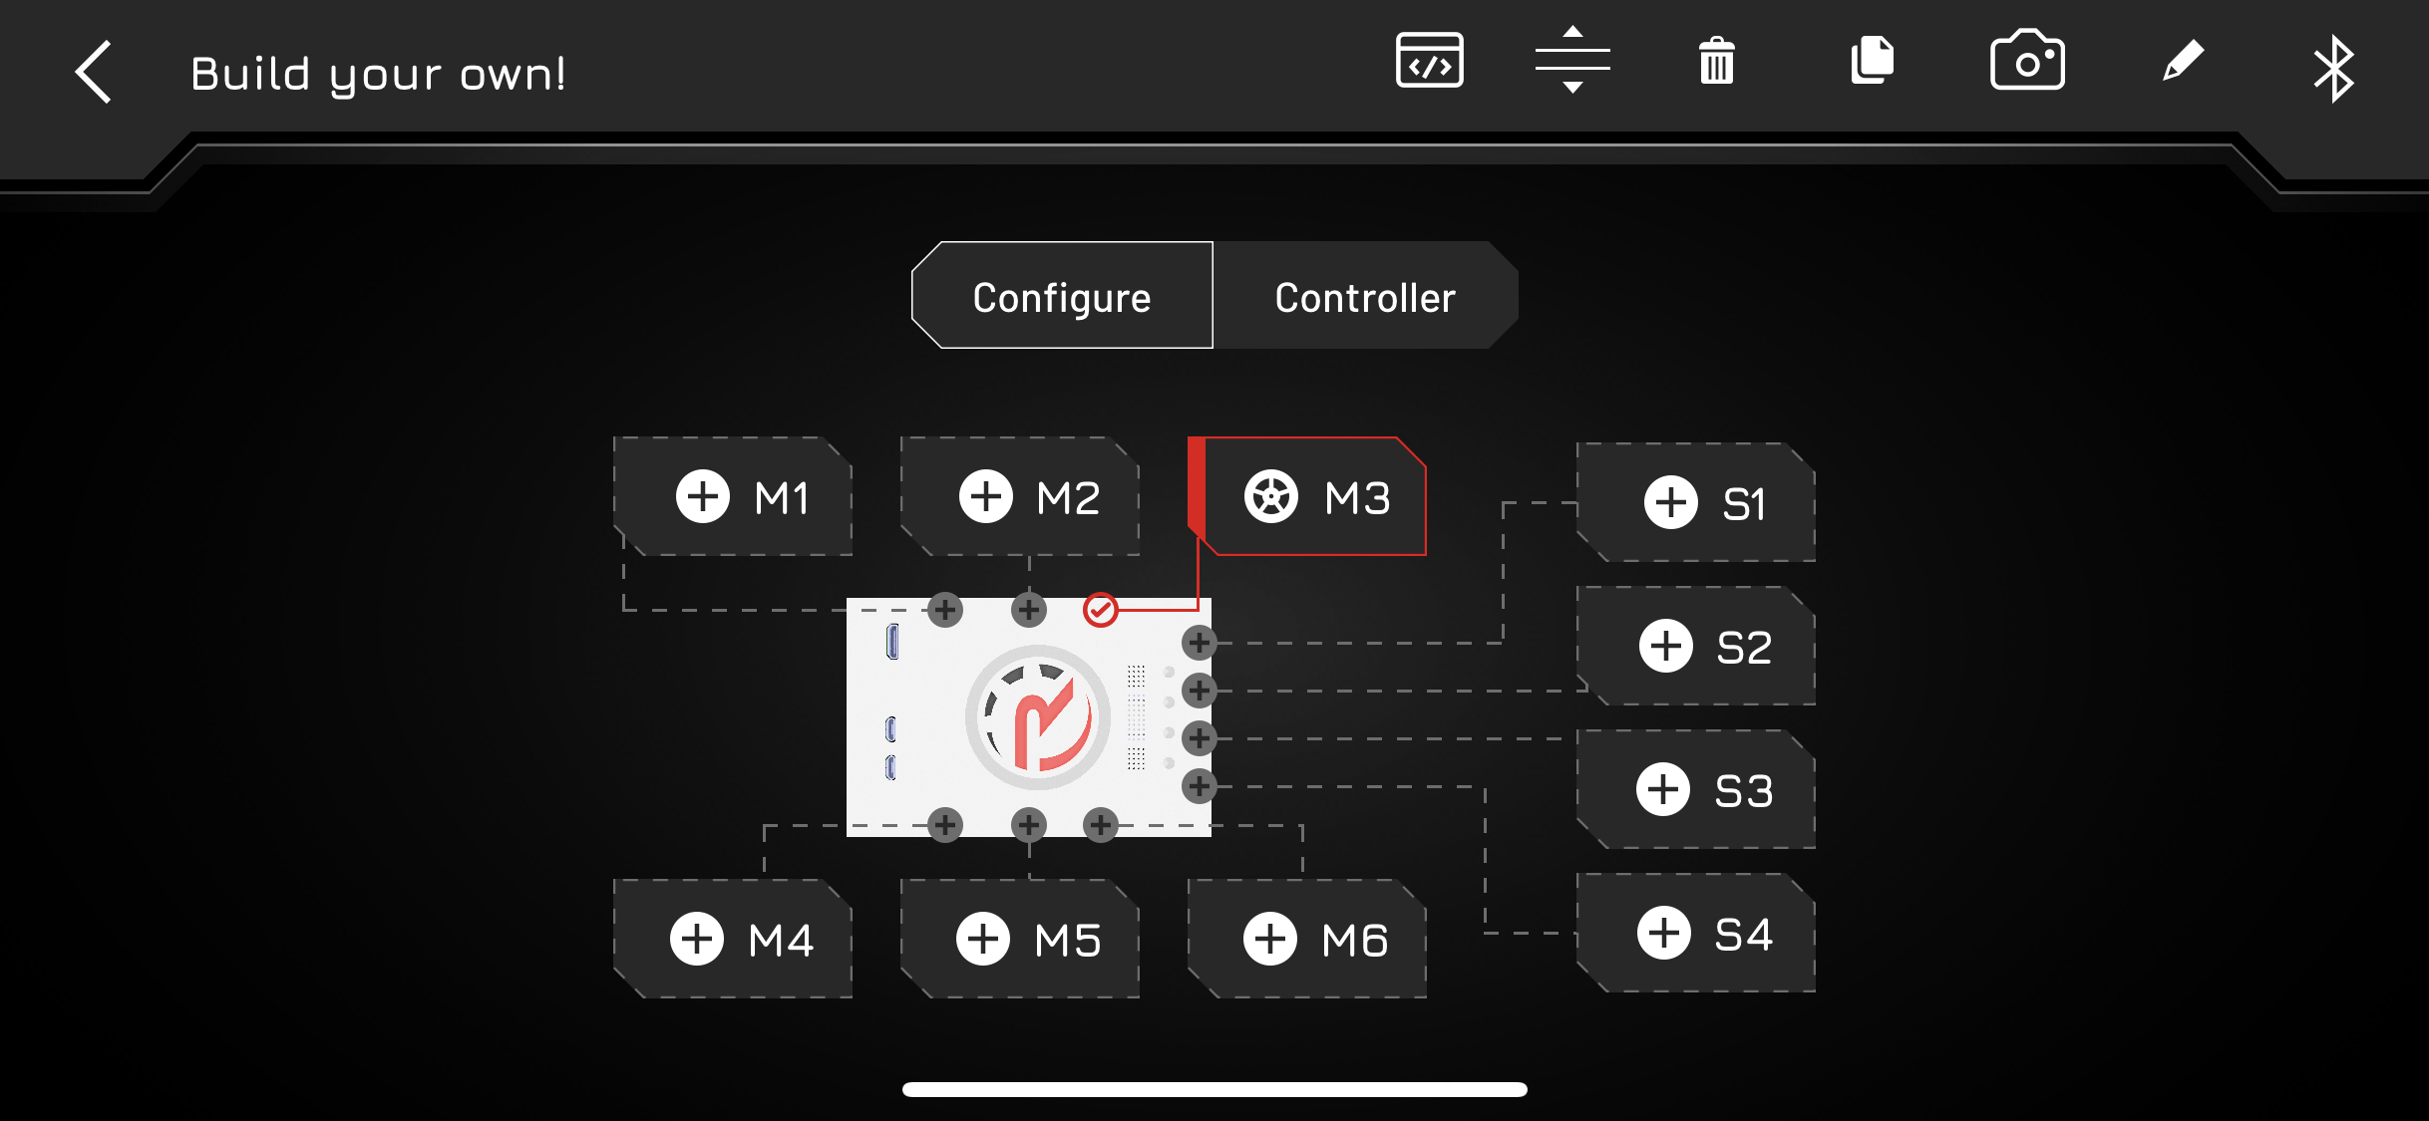
Screen 1 – Config screen
Start the app here, no back button
Add a play button
Remove UI elements (red)

Slide 4
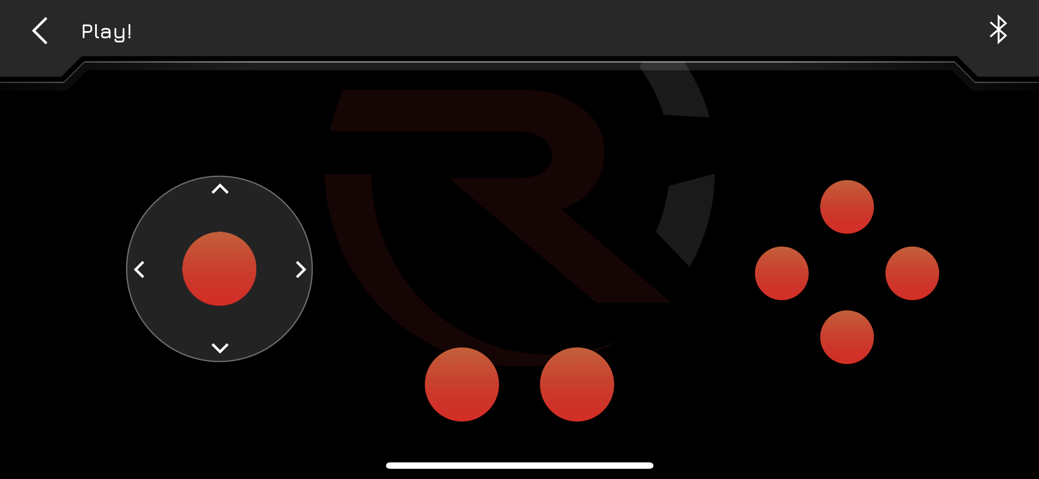
Screen 2 – Remote controller
Only for drivetrain test, buttons can be greyed out
Back button to config screen

Slide 5
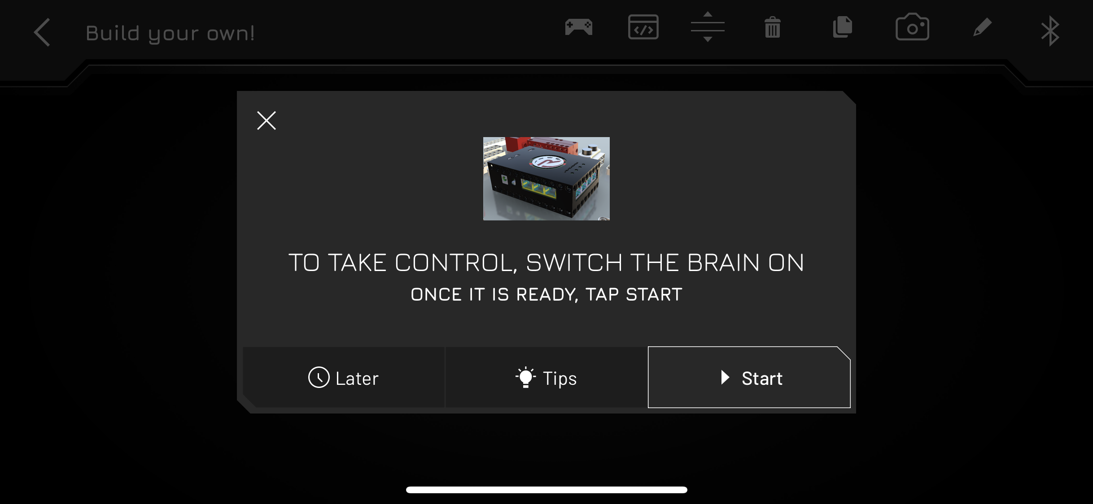
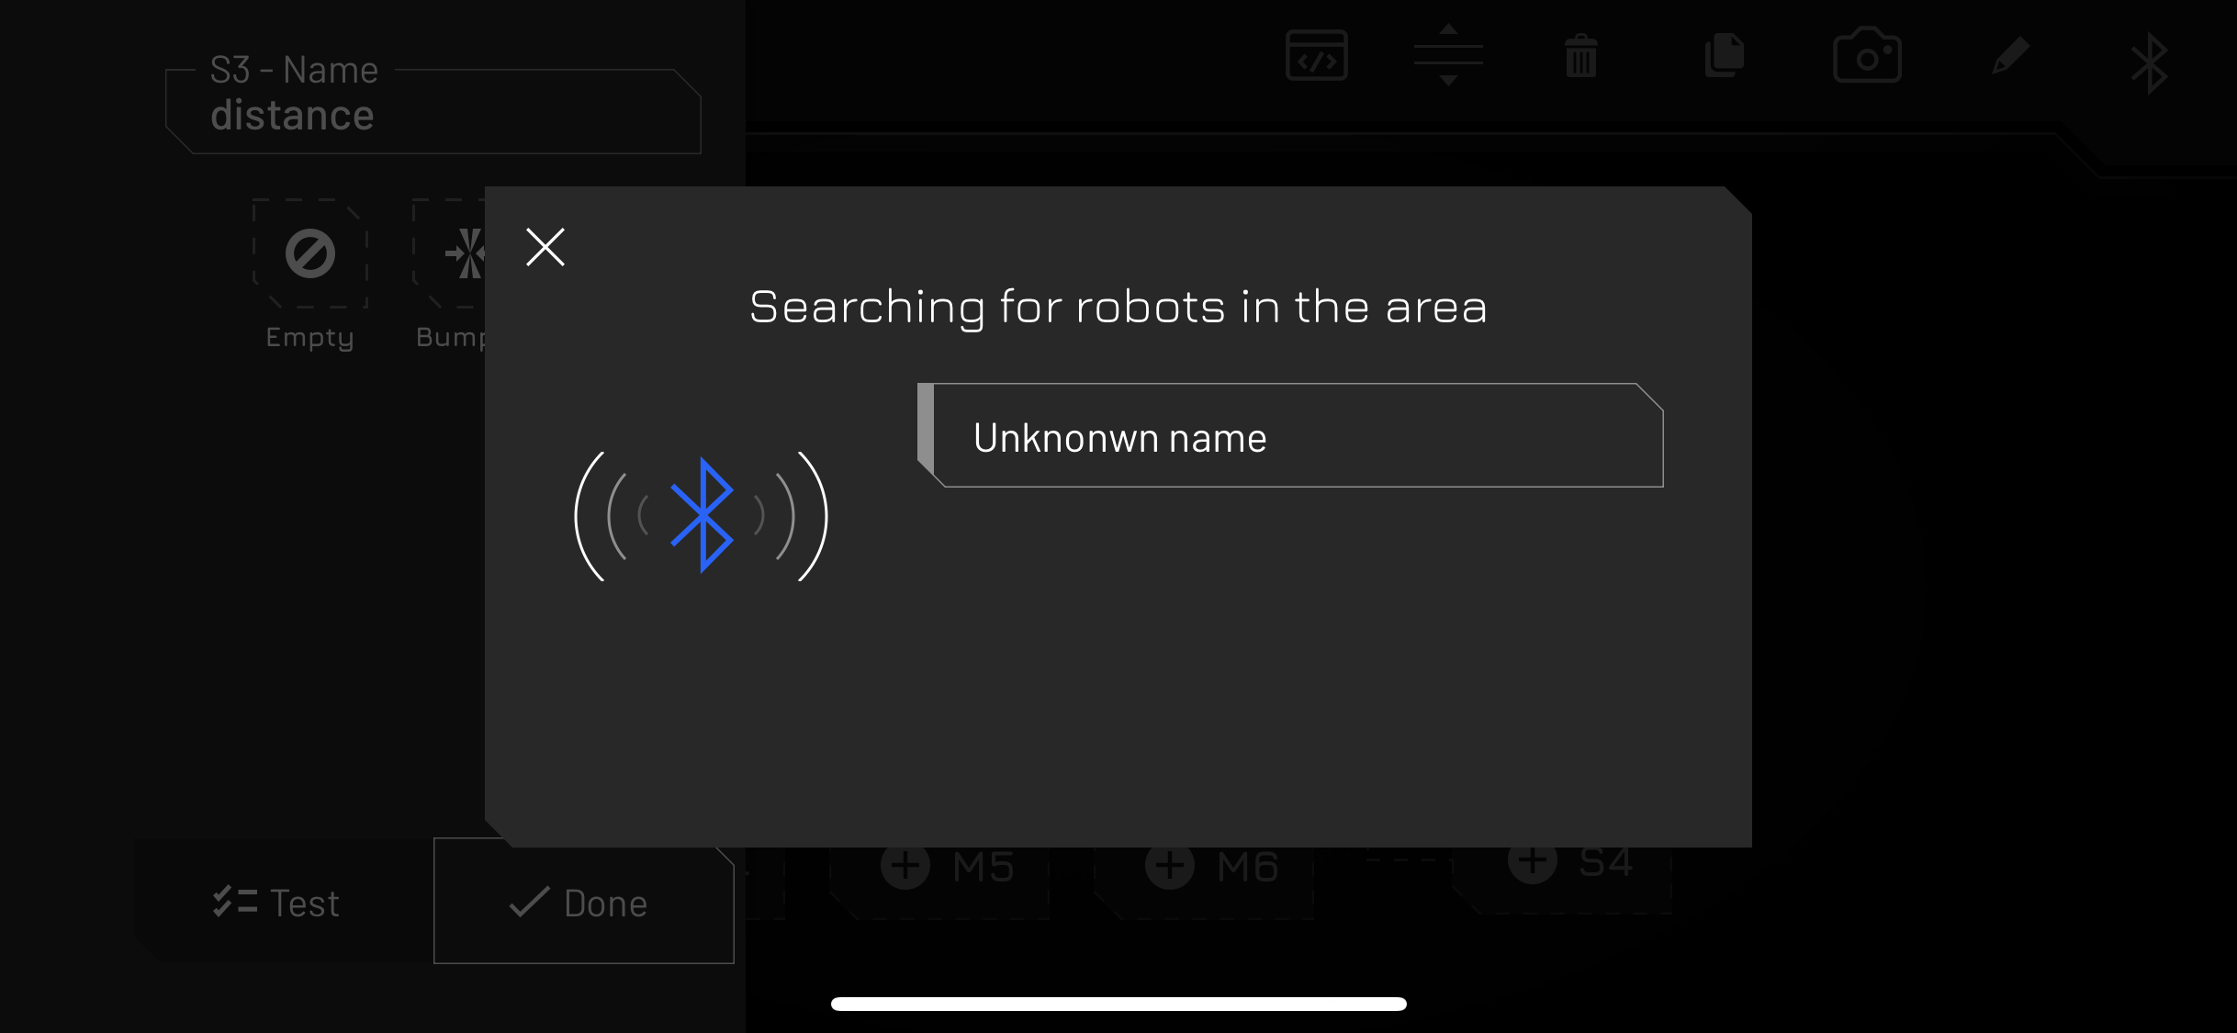
Bluetooth connection modal
Don’t need help screen, show devices immediately

